Slide 1
THE REIMER–TIEMANN REACTION

Slide 2
Origin
In 1876 they isolated and identified hydroxyaldehydes as the principal reaction products of phenol and chloroform in alkaline medium. The scope of this reaction was enlarged in 1884 by von Auwers, who discovered the chlorine-containing cyclohexadienones as by-products in the formylation of alkylphenols. The ring-expansion products, namely, chloropyridines, were first noted by Ciamician when he subjected pyrroles to Reimer–Tiemann reaction conditions. Nearly half a century passed before Woodward recognized that the conversion of an alkylphenol to a substituted cyclohexadienone could lead to the synthesis of terpenes and steroids containing an angular methyl group. Although the method failed as a preparatively useful approach to the synthesis of steroids, an A/B trans-fused hexahydrophenanthrene was prepared using a Reimer–Tiemann reaction. The reaction was last reviewed some 20 years ago..

Slide 3
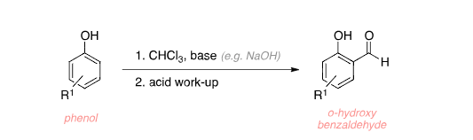
The Reimer–Tiemann reaction Is an aromatic substitution reaction that occurs under basic conditions used for the ortho-formylation of phenols with the simplest example being the conversion of phenol to salicylaldehyde.
Riemer-tiemann Reaction

Slide 4
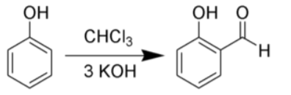
When phenols i.e. C₆H₅OH is treated with CHCl₃ (chloroform) in the presence of NaOH (sodium hydroxide), an aldehyde group (-CHO) is introduced at the ortho position of the benzene ring leading to the formation of o-hydroxybenzaldehyde. The reaction is popularly known as the Reimer Tiemann reaction.
Substitution of Hydroxy group
phenol
O-hydoxybenzaldehyde

Slide 5
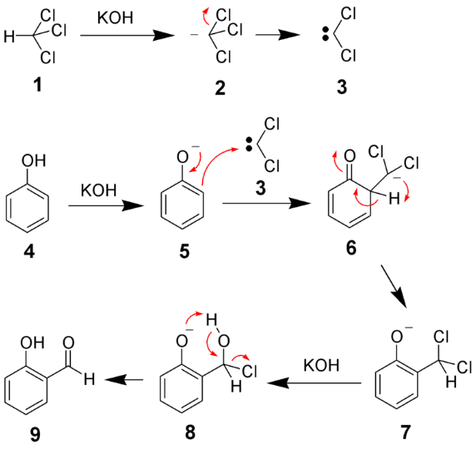
#Step1) The chloroform is deprotonated by the strongly basic aqueous hydroxide solution, giving the chloroform carbanion namely Di-Chlorocarbene It is an Electrophile and levis acid .
Steps for mechanism of Riemar-Tiemann
chloroform
Dichlorocarbene
H20 + KCl

Slide 6
#Step2) The aqueous hydroxide also deprotonates the phenol reactant, yielding a negatively charged phenoxide.
Steps for mechanism of Riemar-Tiemann
phenol
Phenoxide ion

Slide 7
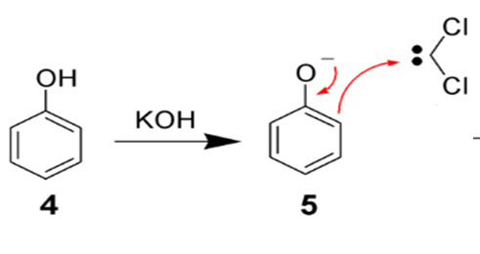
#Step3) This negative charge is now delocalized into the benzene ring, causing it to be far more nucleophilic.
Steps for mechanism of Riemar-Tiemann
Phenoxide ion

Slide 8
#Step4) This results in a nucleophilic attack on the dichlorocarbene, forming an intermediate dichloromethyl substituted phenol.
Steps for mechanism of Riemar-Tiemann
dichlorocarbene
Phenoxide ion
Benzal intermediate

Slide 9
#Step5) This intermediate is subjected to basic hydrolysis to finally achieve the formation of the desired ortho-hydroxybenzaldehyde Thus, the given phenol is converted into an ortho-hydroxy benzaldehyde using chloroform, a base and acid workup
Steps for mechanism of Riemar-Tiemann
O-hydroxybenaldehye
Benzal intermediate

Slide 10
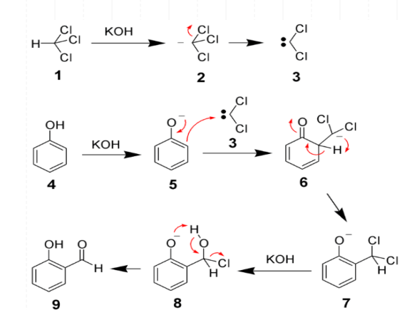

Slide 11
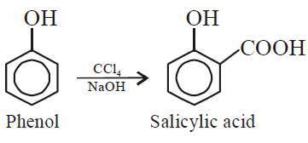
Applications of Reimer–Tiemann reaction
Ortho-Formylation of phenols.( phenol to salicylaldehyde )
By replacing Chloroform with carbon tetrachloride (CCL4) the process can be slightly altered to produce Phenolic acid like salicylic acid

Slide 12
THANKYOU!
Branch: Comp
@Bhairavi Gawas_ 21F053_16
@Mangesh Phadte_21F072_41

